Slide 1
Lecture 13 - Multifactor ANOVA
Bill Perry

Slide 2
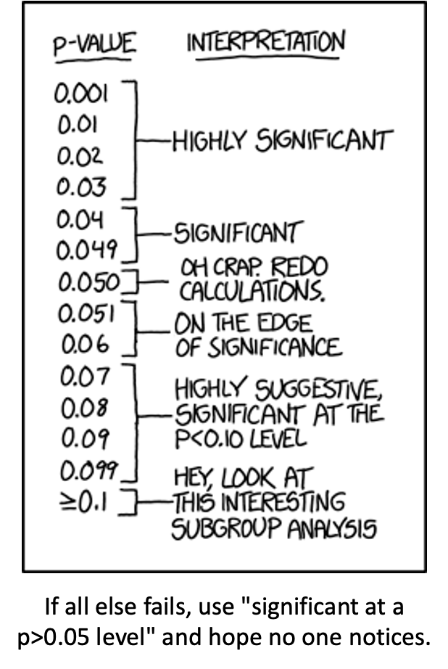
Lecture 12: Review
ANOVA
Analysis of variance: single and multi-factor designs
Examples: diatoms, circadian rhythms
Predictor variables: fixed vs. random
ANOVA model
Analysis and partitioning of variance
Null hypothesis
Assumptions and diagnostics
Post F Tests - Tukey and others
Reporting the results

Slide 3
Lecture 13: Multifactor ANOVA Overview
Multifactor ANOVA
nested and factorial designs
Nested design examples
Factorial design examples
Nested designs
Linear model
Analysis of variance
Null hypotheses
Unbalanced designs
Assumptions

Slide 4
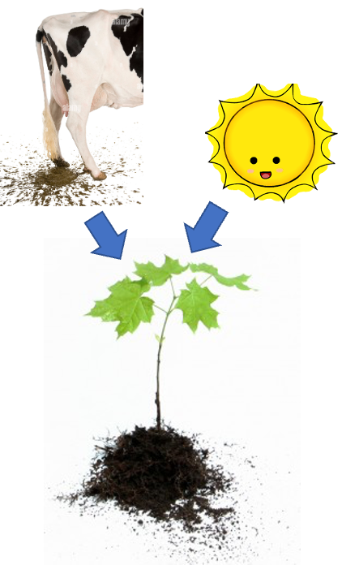
Lecture 13: 2 Factor or 2 Way ANOVA
Often consider more than 1 factor (independent categorical variable):
reduce unexplained variance
look at interactions
2-factor designs (2-way ANOVA) very common in ecology
Can have more factors (e.g., 3-way ANOVA)
interpretation tricky…
Most multifactor designs: nested or factorial

Slide 5
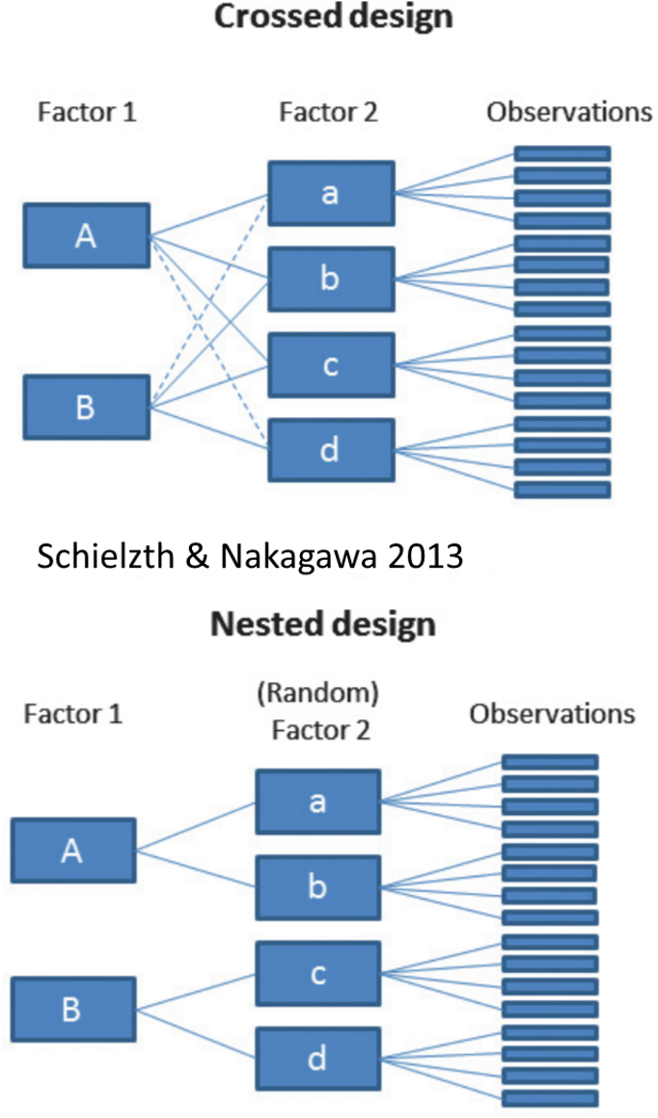
Lecture 13: Nested and factorial designs
Consider two factors: A and B
Nested/hierarchical: levels of B occur only in 1 level of A
Factorial/crossed: every level of B in every level of A

Slide 6
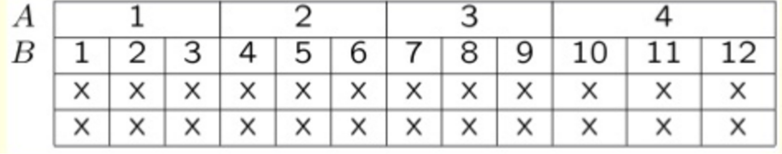
Lecture 13: Nested and factorial designs
Nested Designs:
Factor A usually fixed
Factor B usually random

Slide 7
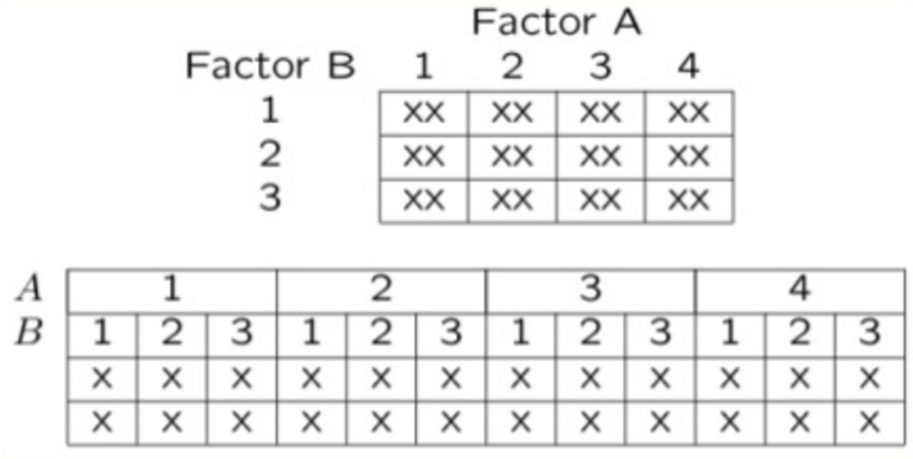
Lecture 13: Nested and factorial designs
Factorial Designs:
Both factors typically fixed (but not always)

Slide 8
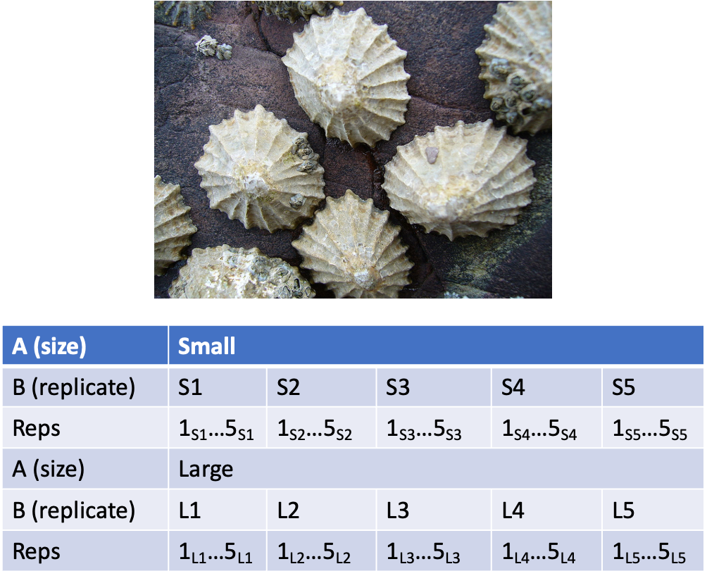
Lecture 13: Nested designs: examples
Study on effects of enclosure size on limpet growth:
2 enclosure sizes (factor A)
5 replicate enclosures (factor B)
5 replicate limpets per enclosure

Slide 9
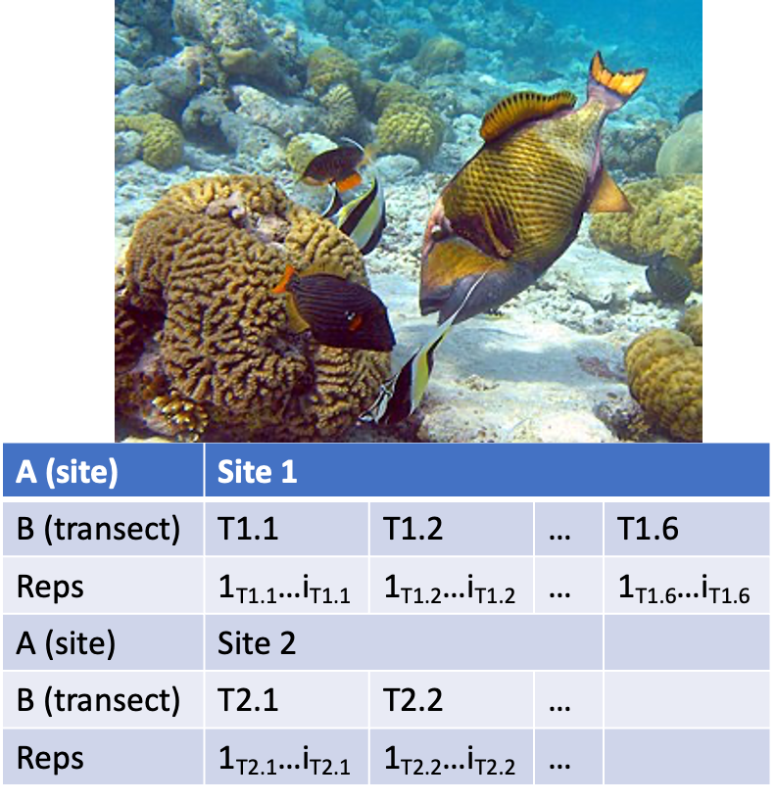
Lecture 13: Nested designs: examples
Study on reef fish recruitment: 5 sites (factor A) 6 transects at each site (factor B) replicate observations along each transect

Slide 10
Lecture 13: Nested designs: examples
Effects of sea urchin grazing on biomass of filamentous algae:
4 levels of urchin grazing: none, L, M, H
4 patches of rocky bottom (3-4 m2) nested in each level of grazing
5 replicate quadrats per patch
F

Slide 11
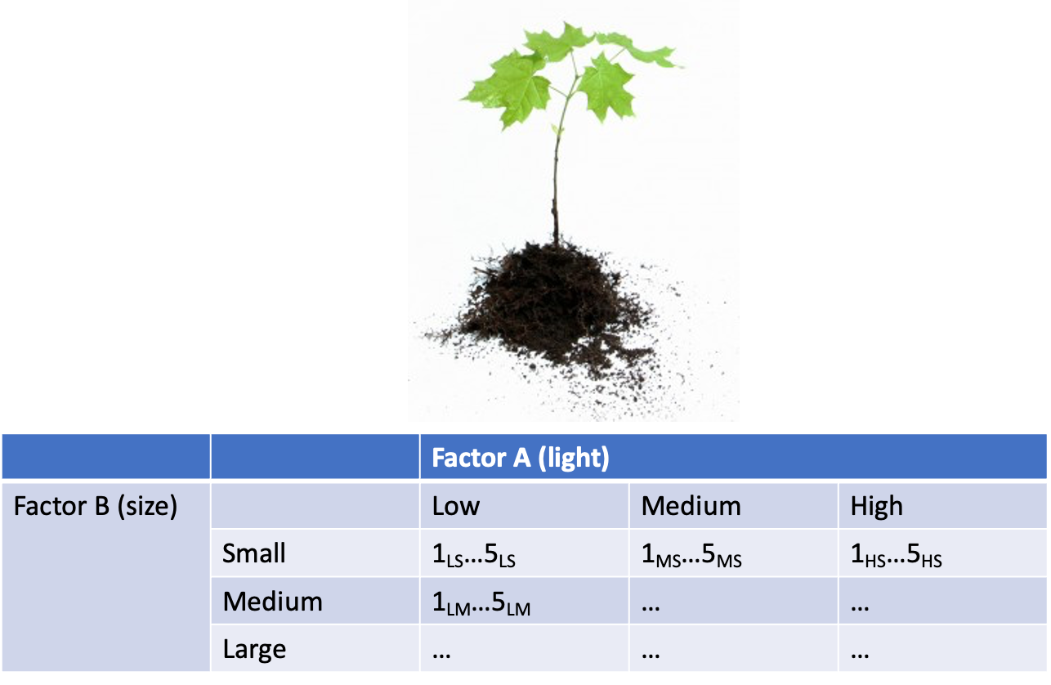
Lecture 13: Factorial designs: examples
Effects of light level on growth of seedlings of different size:
3 light levels (factor A)
3 size classes (factor B)
5 replicate seeding in each cell

Slide 12
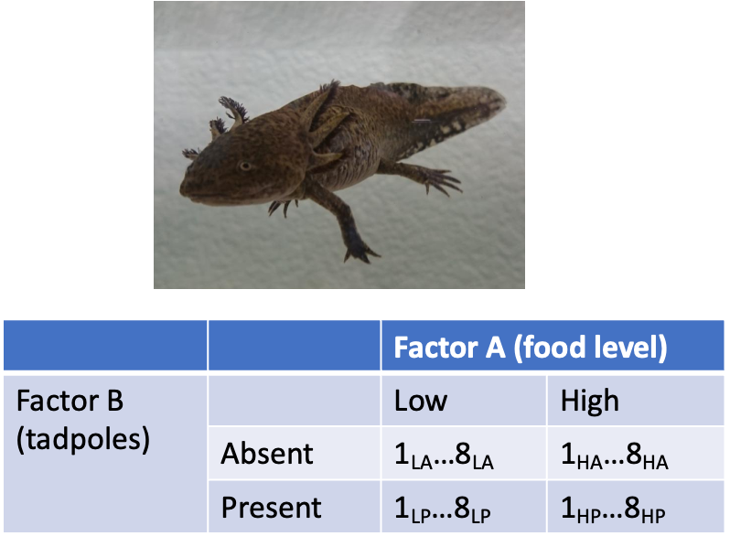
Lecture 13: Factorial designs: examples
Effects of food level and tadpole presence on larval salamander growth
2 food levels (factor A)
presence/absence of tadpoles (factor B)
8 replicates in each cell

Slide 13
Lecture 13: Factorial designs: examples
Effect of season and density on limpet fecundity.
2 seasons (factor A)
4 density treatments (factor B)
3 replicates in each cell
F

Slide 14
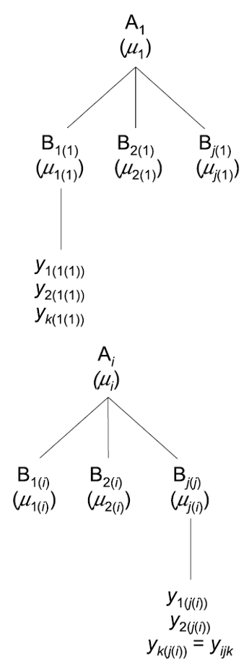
Lecture 13: Nested designs: linear model
Consider a nested design with:
p levels of factor A (i= 1…p) (e.g., 4 grazing levels)
q levels of factor B (j= 1…q), nested within each level of A (e.g., 4 - diff. patches per grazing level)
n replicates (k= 1…n) in each combination of A and B (5 replicate - quadrats in each patch in each grazing level)

Slide 15
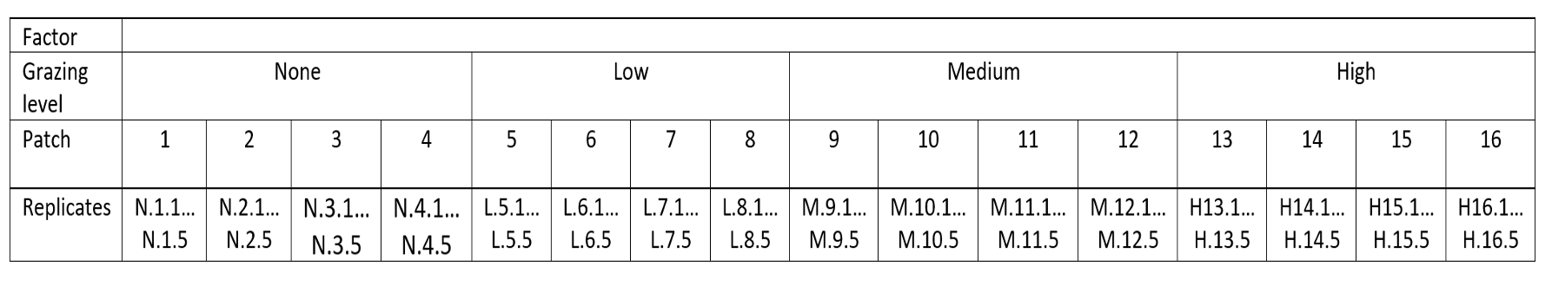
Lecture 13: Nested designs: linear model
Can calculate several means:
overall mean (across all levels of A and B)= ȳ;
a mean for each level of A (across all levels of B in that A)= ȳi;
a mean for each level of B within each A= ȳj(i)

Slide 16
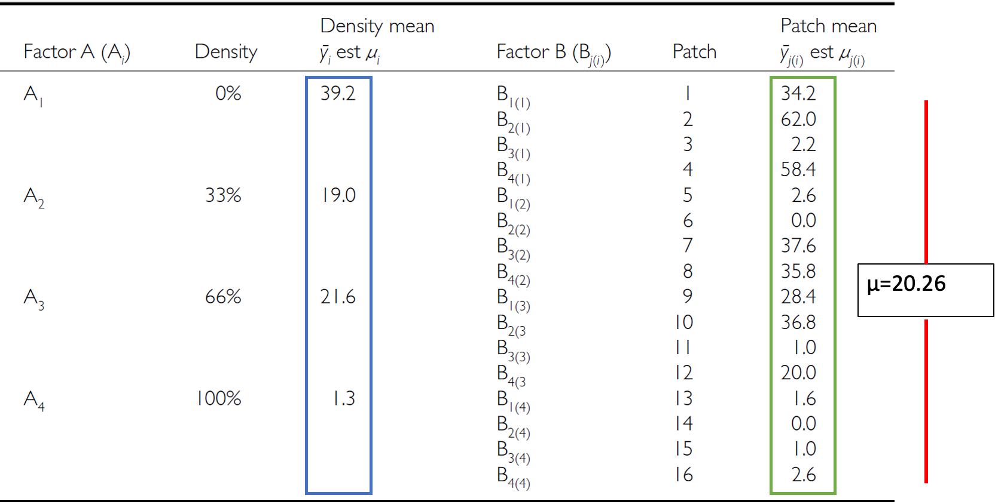
Lecture 13: Nested designs: linear model

Slide 17
Lecture 13: Nested designs: linear model
The linear model for a nested design is: $$y_{ijk}=μ+α_{i}+β_{j\left(i\right)}+ε_{ijk}$$
Where:
$y_{ijk}$ is the response variable
value of the k-th replicate in j-th level of B in the i-th level of A
(algal biomass in 3rd quadrat, in 2nd patch in low grazing treatment)
$μ$ is the overall mean
(overall average algal biomass)

Slide 18
Lecture 13: Nested designs: linear model
The linear model for a nested design is:
The linear model for a nested design is: $$y_{ijk}=μ+α_{i}+β_{j\left(i\right)}+ε_{ijk}$$
$α_{i}$ is the fixed effect of factor $i$
(difference between average biomass in all low grazing level quadrats and overall mean)
$β_{j\left(i\right)}$ is the random effect of factor $j$ nested within factor $i$
usually random variable, measuring variance among all possible levels of B within each level of A
(variance among all possible patches that may have been used in the low grazing treatment)

Slide 19
Lecture 13: Nested designs: linear model
The linear model for a nested design is:
The linear model for a nested design is: $$y_{ijk}=μ+α_{i}+β_{j\left(i\right)}+ε_{ijk}$$
$ε_{ijk}$ is the error term
αi: is the effect of the ith level of A: µi- µ
unexplained variance associated with the kth replicate in jth level of B in the ith level of A
(difference bw observed algal biomass in 3rd quadrat in 2nd patch in low grazing treatment and predicted biomass - average biomass in 2nd patch in low grazing treatment)

Slide 20
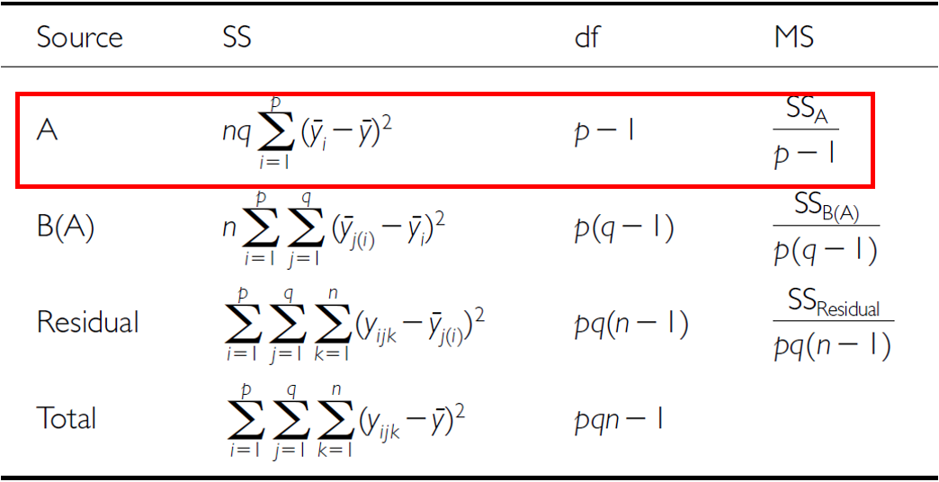
Lecture 13: Nested designs: analysis of variance
As before, partition the variance in the response variable using SS SSA is SS of differences between means in each level of A and overall mean

Slide 21
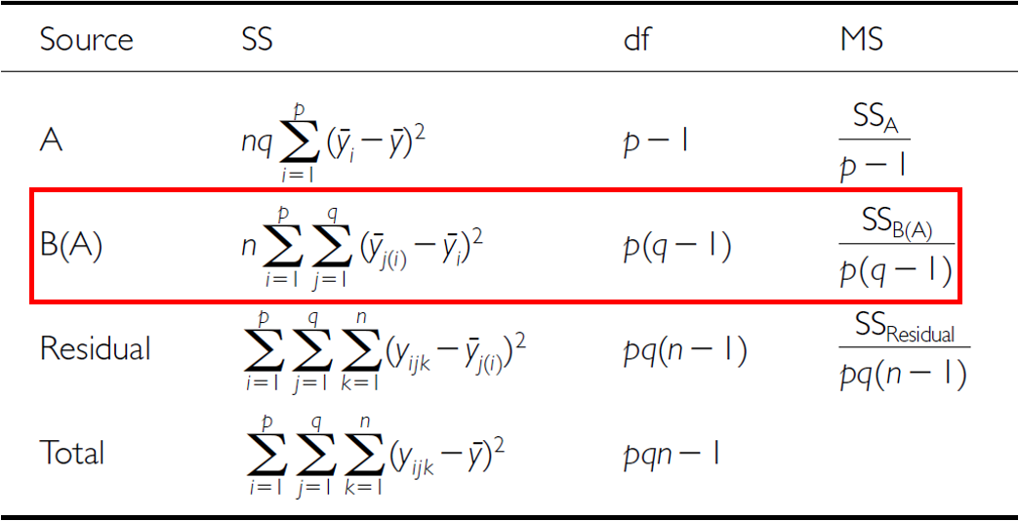
Lecture 13: Multifactor ANOVA
SSB is SS of difference between means in each level of B and the mean of corresponding level of A summed across levels of A

Slide 22
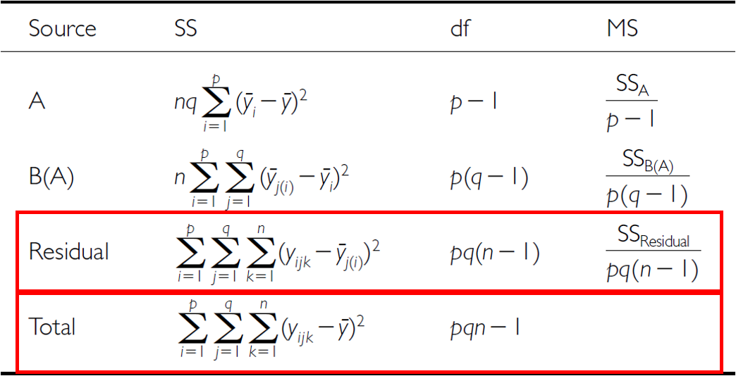
Lecture 13: Nested designs: analysis of variance
SSresid is difference bw each observation and mean for its level of factor B, summed over all observations
SStotal = SSA + SSB + SSresid
SS can be turned into MS by dividing by appropriate df

Slide 23
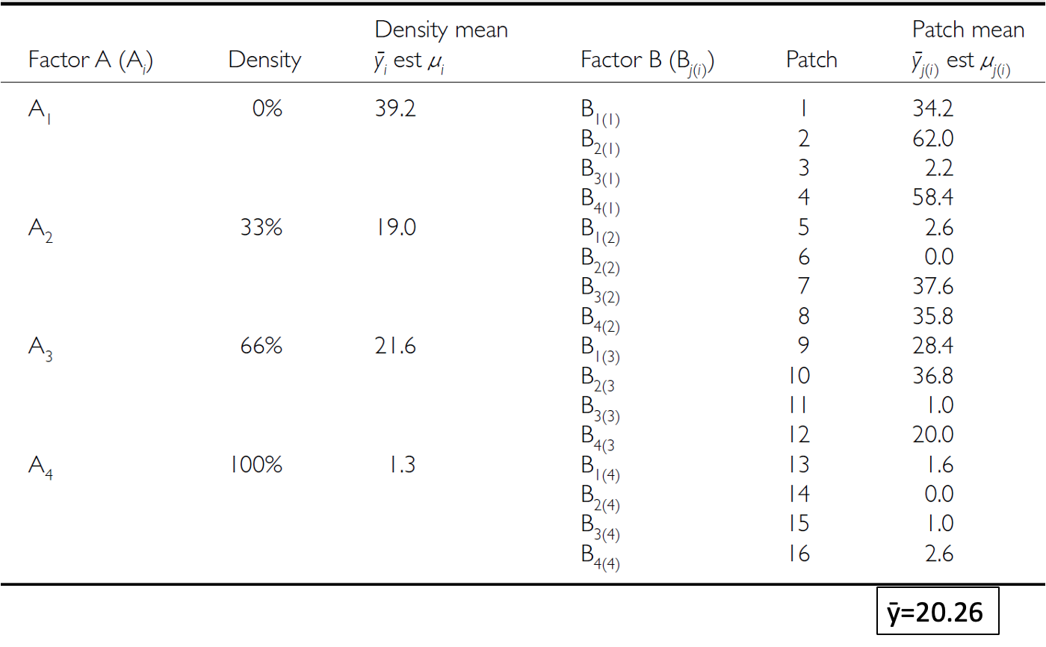
Lecture 13: Nested designs: analysis of variance

Slide 24
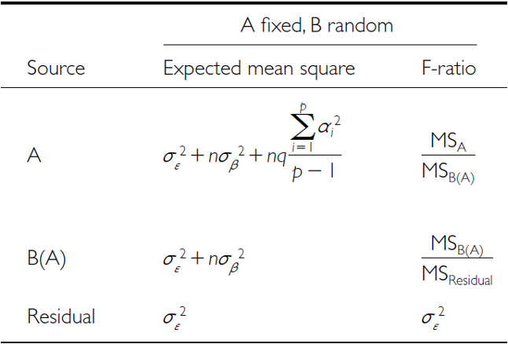
Lecture 13: Nested designs: null hypotheses
Two hypotheses tested on values of MS:
no effects of factor A
Assuming A is fixed:
Ho(A): µ1= µ2= µ3=…. µi= µ
Same as in 1-factor ANOVA, using means from B factors nested within each - level of A
(no difference in algal biomass across all levels of grazing: µnone= - µlow= µmed= µhigh)

Slide 25
Lecture 13: Nested designs: null hypotheses
Two hypotheses tested on values of MS:
No effects of factor B nested in A
Assuming B is random:
Ho(B): σβ2= 0 (no variance added due to differences between all possible - levels of B)
(no variance added due to differences between patches)

Slide 26
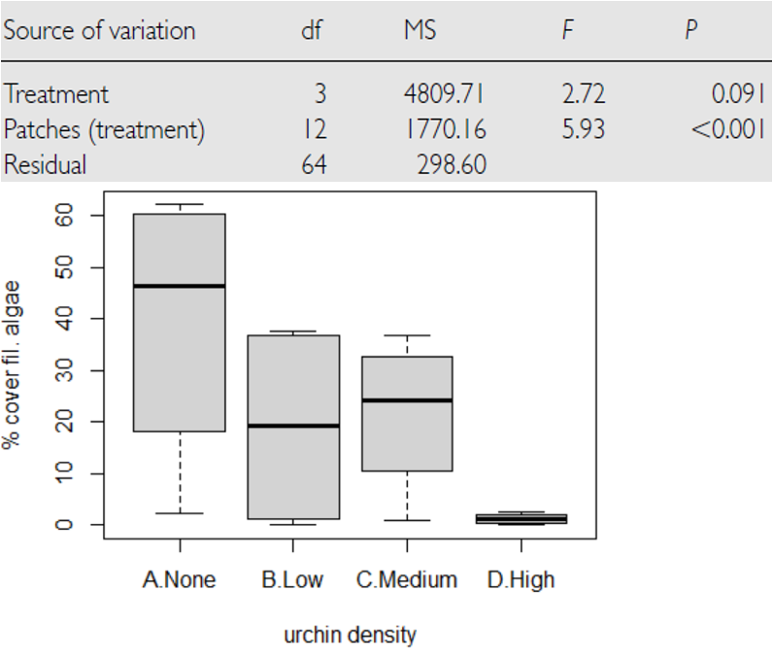
Lecture 13: Nested designs: null hypotheses
Conclusions?
“significant variation between replicate patches within each treatment, but no significant difference in amount of filamentous algae between treatments”

Slide 27
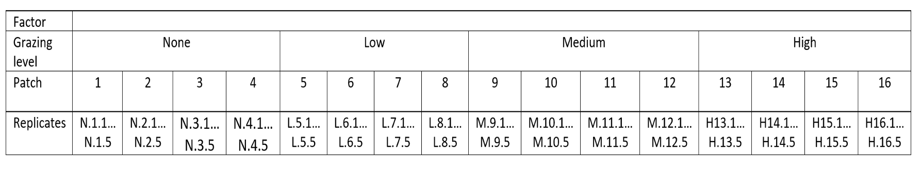
Lecture 13: Nested designs: unbalanced designs
Unequal sample sizes can be because of:
uneven number of B levels within each A
uneven number of replicates within each level of B
Not a problem, unless have unequal variance or large deviation from - normality

Slide 28
Lecture 13: Nested designs: assumptions
As usual, we assume
equal variance
normality
independence of observations
Equal variance + normality need to be assessed at both levels:
Since means for each level of B within each A are used for the H-test about A, need to assess whether those means meet normality and equal variance
Examine residuals for H-test about B
Transformations can be used

